Slide 1
Fraud Detection with Machine Learning
Aishwarya Kadam
Notes:
ID=d924773e-9a16-4d6d-9803-8cb819e99682 Recipe=text_billboard Type=TextOnly Variant=0 FamilyID=AccentBoxWalbaum_Zero

Slide 2
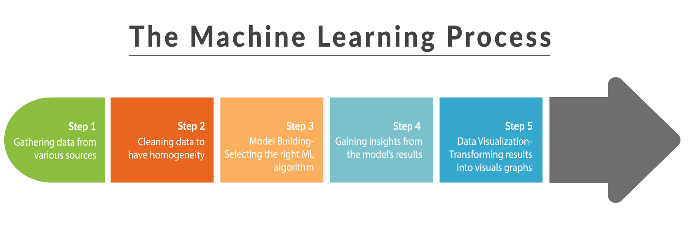

Slide 3

Introduction
Topic: online payments fraud detection with machine learning using Python. Pandas ,NumPy libraries used
Tools: Jupiter Notebook
Data is in the csv file we collected the dataset from Kaggle, which contains historical information about fraudulent transactions which can be used to detect fraud in online payments.
To identify online payment fraud with machine learning, we need to train a machine learning model for classifying fraudulent and non-fraudulent payments.
Supervised machine learning algorithm used

Slide 4
Steps

Slide 5
The way to get started is to quit talking and begin doing.
Walt Disney

Slide 6
Content
Subtitle
Subtitle
Subtitle
Add text, images, art, and videos.
Add transitions, animations, and motion.
Save to OneDrive, to get to your presentations from your computer, tablet, or phone.
Open the Design Ideas pane for instant slide makeovers.
When we have design ideas, we’ll show them to you right there.
This PowerPoint theme uses its own unique set of colors, fonts, and effects to create the overall look and feel of these slides.
PowerPoint has tons of themes to give your presentation just the right personality.

Slide 7



Summary
So this is how we can detect online payments fraud with machine learning using Python. Detecting online payment frauds is one of the applications of data science in finance

Slide 8







Thank you
Aishwarya kadam
kadamaishwarya12345@gmail.com
Website we referred:
https://thecleverprogrammer.com/2022/02/22/online-payments-fraud-detection-with-machine-learning/

